Slide 1
Workflow Automation using GCP Cloud Composer

Slide 2
Revision History
Version | Date | Author | Reviewed by | Comments
1.0 | 26-Feb-2025 | Jyothi Shivakumar |  | Initial Version

Slide 3
Understand cloud composer & workflow automation concepts
Build & manage workflows using apache airflow
Integrate with google cloud services
Solve the Challenges in workflow automation.

Slide 4

Introduction to Workflow Automation

Slide 5
Introduction
What is workflow automation?
Automating a sequence of tasks based on a defined schedule or triggers.
Common in data pipelines, ML workflows, ETL processes, etc.
Why is it important?
Reduces manual effort, minimizes errors, and increases efficiency.
Ensures workflows run consistently without manual intervention.
Challenges of manual workflows:
Human errors, delays, and lack of scalability.

Slide 6
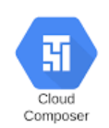
Introduction to Cloud Composer

Slide 7
Understanding Cloud Composer in GCP
What is Cloud Composer?
A fully managed orchestration service based on Apache Airflow.
Allows users to automate complex workflows using Python scripts.
Supports integrations with GCP services like BigQuery, GCS, Dataflow, and Dataproc.
Key Benefits:
Scalability: Google Cloud automatically manages resources.
Reliability: Built-in monitoring, logging, and alerting.
Integration: Works with GCP, on-premise, and third-party services.

Slide 8
Why Use Cloud Composer?
Automates multi-step workflows in cloud environments.
Reduces operational overhead – no need to manage Airflow clusters manually.
Supports hybrid and multi-cloud environments.
Ensures reliability with logging, monitoring, retries, and alerts

Slide 9
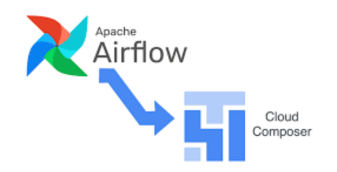
Apache Airflow – The Engine Behind Cloud Composer

Slide 10

Apache Airflow
Apache Airflow Overview:
An open-source platform to programmatically author, schedule, and monitor workflows.
How it works:
Workflows are defined as DAGs (Directed Acyclic Graphs).
Each DAG consists of tasks with dependencies.
Why Airflow?
Scalable, flexible, and extensible with custom Python scripts.

Slide 11
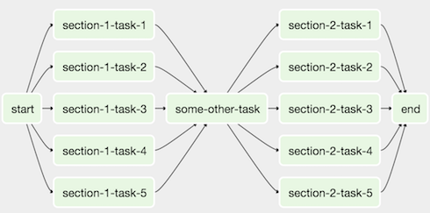
Understanding DAGs in Airflow
What is a DAG?
A Directed Acyclic Graph represents a set of tasks with dependencies.
Key DAG Components:
Operators: Define what actions/tasks should be executed.
Tasks: Units of work (e.g., running a query, copying a file).
Dependencies: Define the sequence of execution.
Example DAG Structure:
Task A → Task B → Task C

Slide 12
Writing a Simple DAG in Cloud Composer
DAGs are written in Python and stored in the Cloud Composer environment.
Define tasks using Airflow Operators (e.g., PythonOperator, BashOperator).
Use scheduling expressions (@daily, @hourly) to automate runs.
Basic DAG Example –
from airflow import DAG
from airflow.operators.dummy import DummyOperator
from datetime import datetime
default_args = {
'owner': 'airflow',
'start_date': datetime(2024, 3, 1),
}
dag = DAG('simple_dag', default_args=default_args, schedule_interval='@daily')
start = DummyOperator(task_id='start', dag=dag)
end = DummyOperator(task_id='end', dag=dag)
start >> end

Slide 13
Cloud Composer Architecture

Slide 14
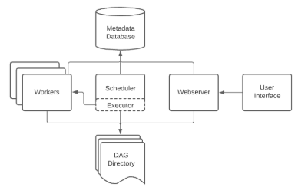
Cloud Composer Architecture
Main Components:
Scheduler: Assigns tasks to workers.
Workers: Execute assigned tasks.
Web Server: Provides Airflow UI for monitoring.
Metadata Database: Stores workflow execution details.
How GCP manages these components automatically.

Slide 15
Integrating Cloud Composer with GCP Services
BigQuery: Automate SQL queries & data analysis.
GCS (Cloud Storage): Manage data transfer & event triggers.
Dataflow: Schedule and run ETL pipelines.
Dataproc: Orchestrate Spark & Hadoop jobs.

Slide 16
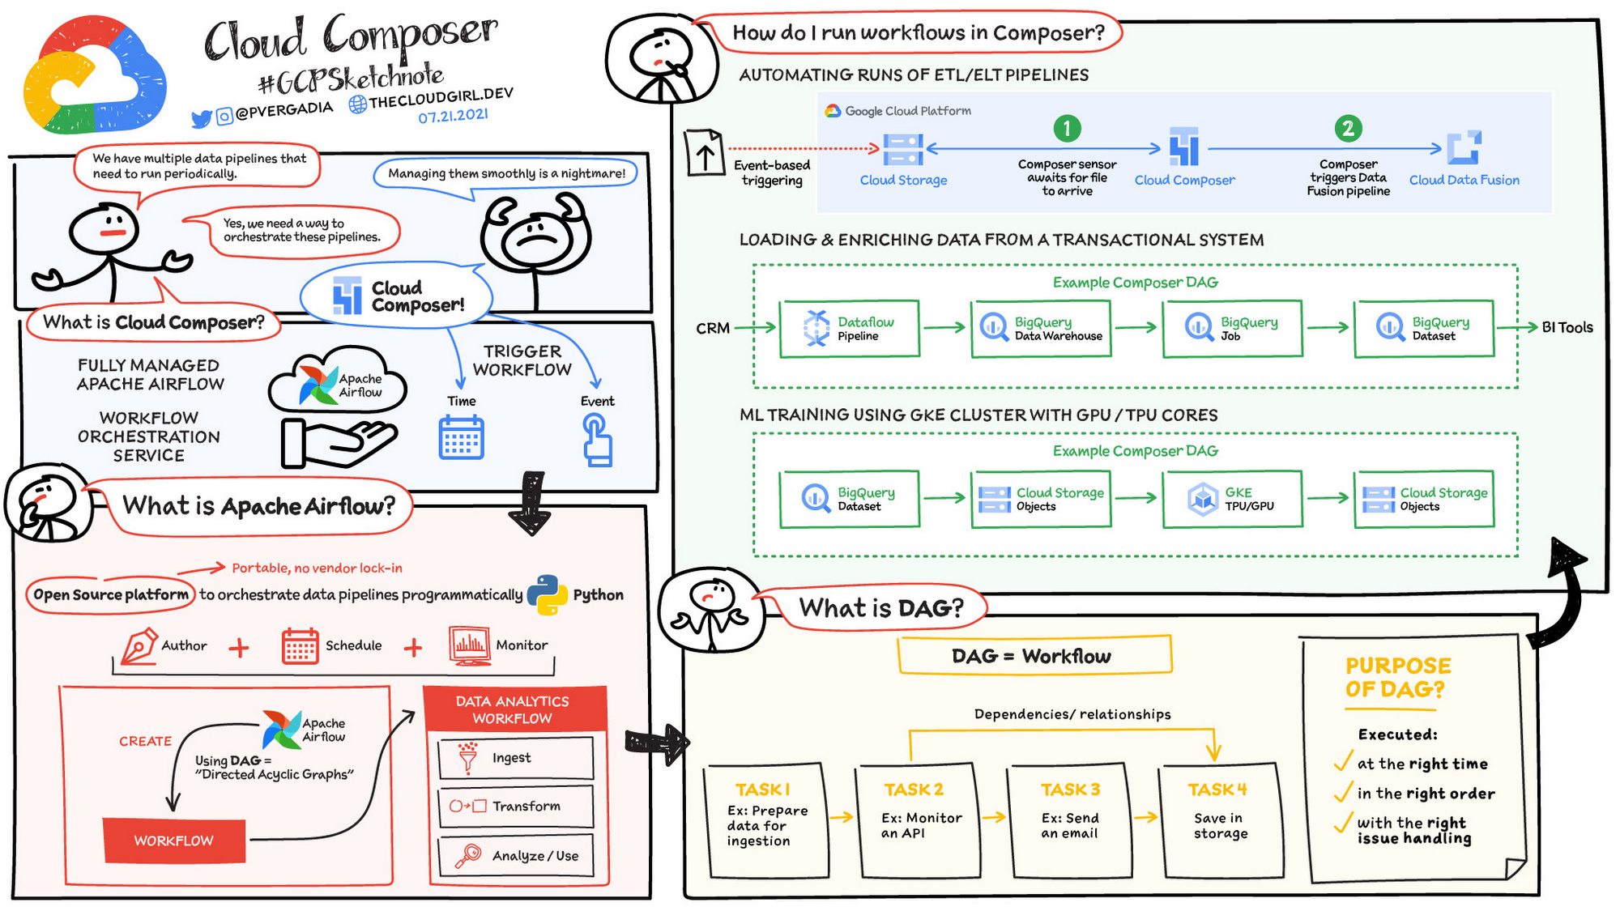

Slide 17
Understand cloud composer & workflow automation concepts
Build & manage workflows using apache airflow
Integrate with google cloud services
Solve the Challenges in workflow automation.

Slide 18
Thank You

